Slide 1
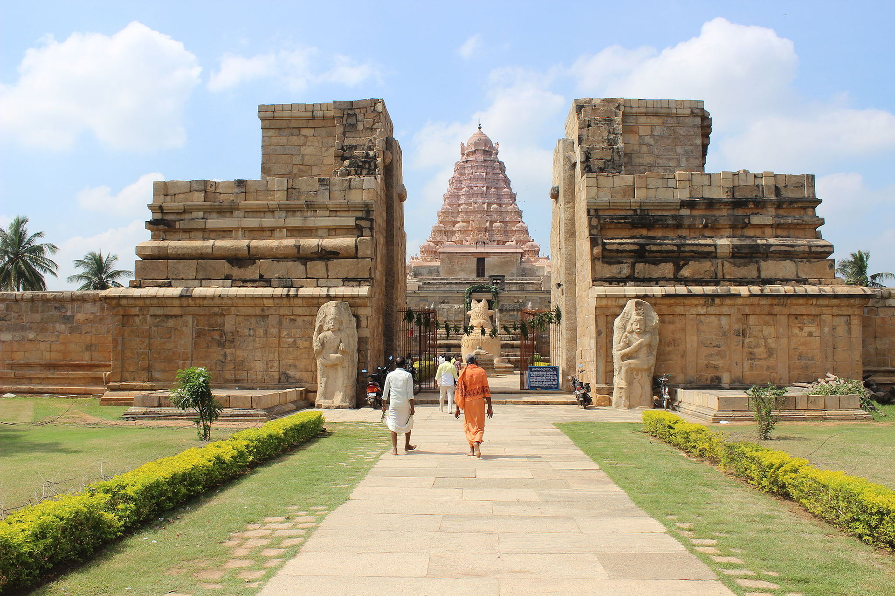
GAHTC
Global Architectural History Teaching Collaborative
Module Template Title Authors Names
Lecture 1: Title of the lecture.
THIS TEMPLATE IS JUST A GUIDE, PLEASE MAKE IT YOUR OWN!
GAHTC ©2017.
Notes:
Lecture Abstract:

Slide 2
GAHTC
Global Architectural History Teaching Collaborative
Module Template Title Authors Names
Lecture 1: Title of the lecture.
Part One: About the template.
Part Two: Full screen image.
Part Three: More images.
Part Four: Checklist/ conclusion.
This could be a contents page for the lecture or a re-cap of the entire module.
GAHTC ©2017.
Notes:
Presenter Note:

Slide 3
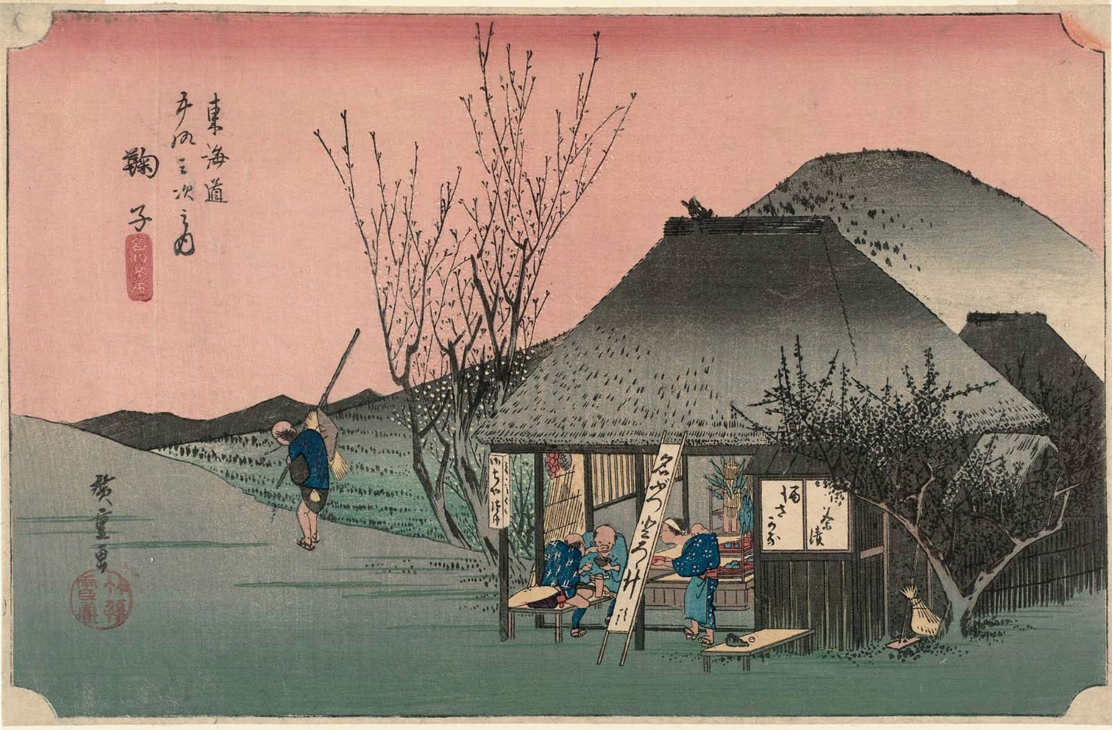
Part One
Subtitle for Part One
This template is an effort to ensure the GAHTC library is able to uphold a high standard of teaching content.
You are under no obligation to use the template – and are free to remix/ rework/ reimagine it in any way that is productive to you.
image: Fifty-three Stations of the Tokaido(ca. 1831-4), Utagawa Hiroshige,woodblock print
GAHTC ©2017.
Notes:
Presenter Note:
Image Source:

Slide 4
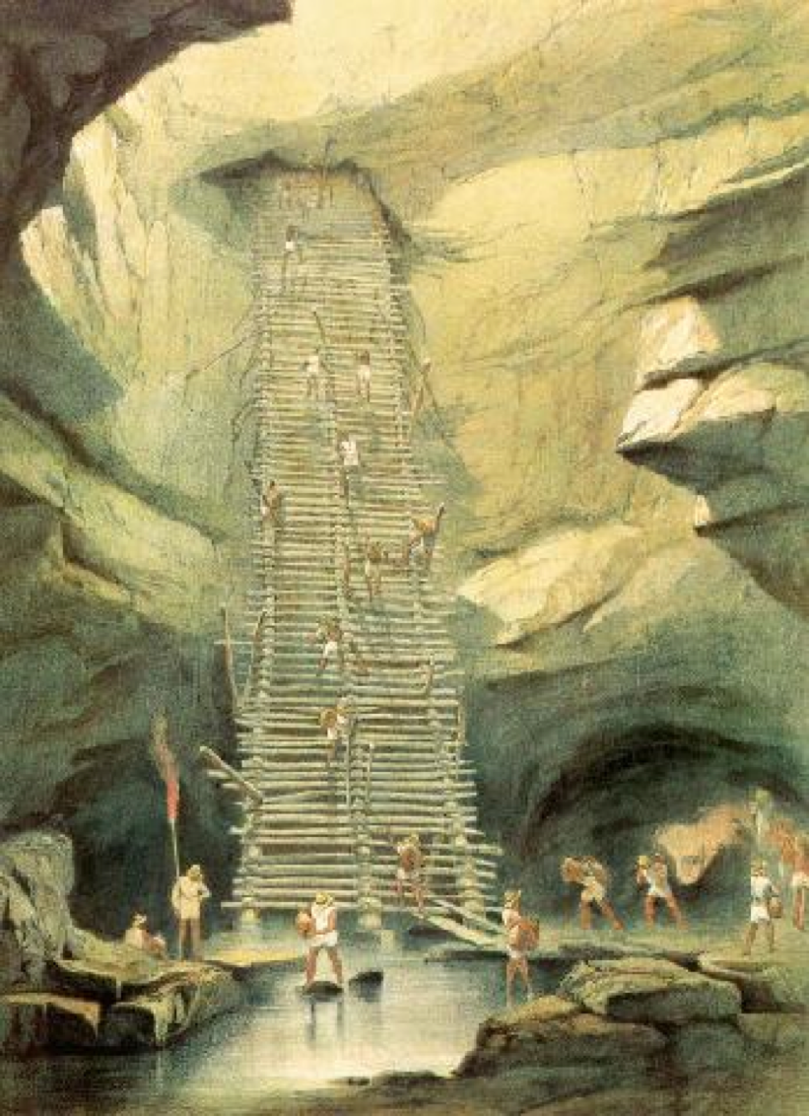
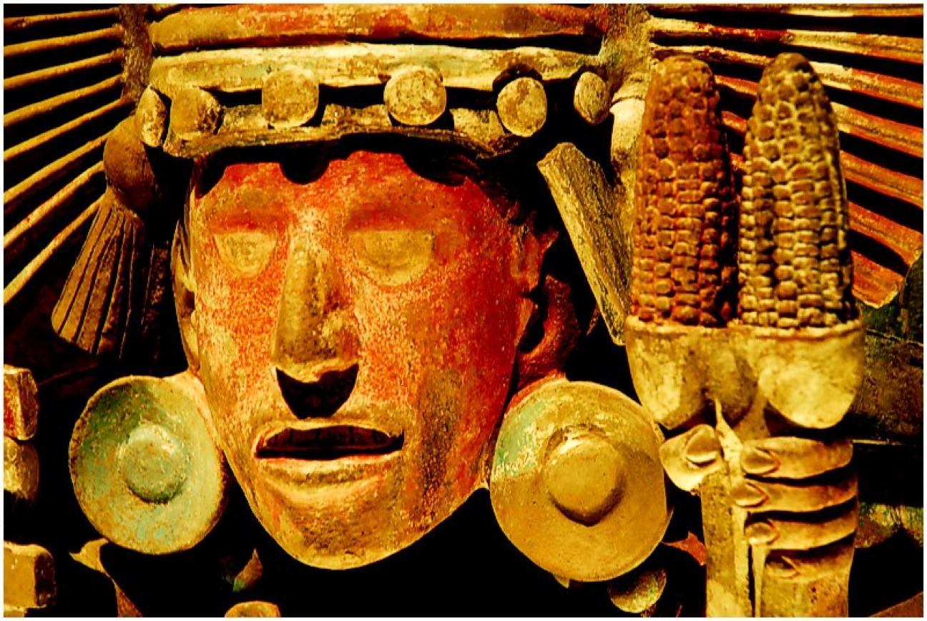
Part One
Continued…
This template includes suggestions for how to lay out your slides.
For a full list of deliverables be sure to consult the “Grant Submission Guidelines” document. The powerpoint slides and lecture notes form the bulk of the teaching material but ancillary documents like quizzes, quiz answers and handouts are crucial.
A strong module that will be useful to other teachers will also have clearly composed module documents like a Syllabus, Lecture Abstracts and Bibliography. These help other professors to quickly understand the scope of the module and conceive how to incorporate it into their own teaching.
image: Centeotl or Cinteotl, Aztec the Lord of Corn.
GAHTC ©2017.
Notes:
Presenter Note:
Image Source:

Slide 5
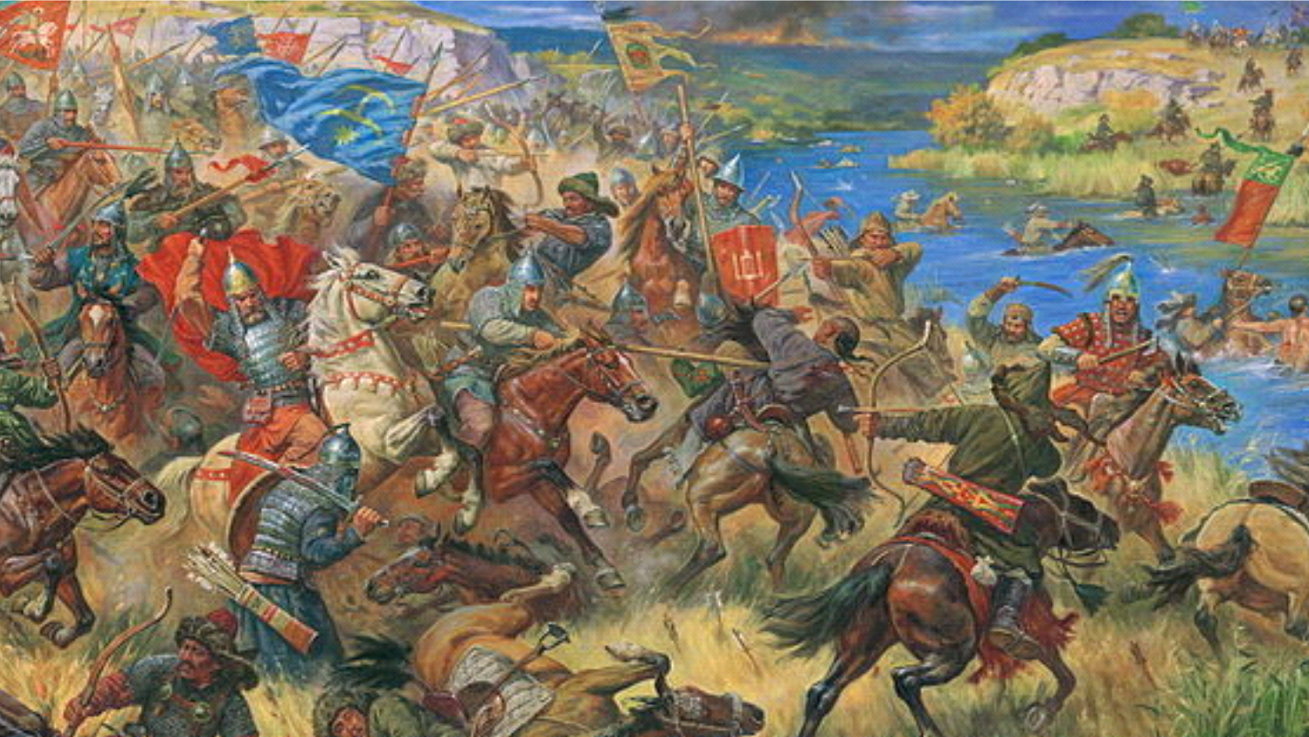
Part Two: Example of a longer Title
And large, full screen image.
Don’t forget to rename all the headings!
GAHTC ©2017.
image: Prince Danilo Ostrozhskiy I the Battle of Blue Waters, 1362, between Grand Duchy of Lithuania and Golden Horde, Artur Orlenov, 2012
Notes:
Presenter Note:
Image Source:

Slide 6
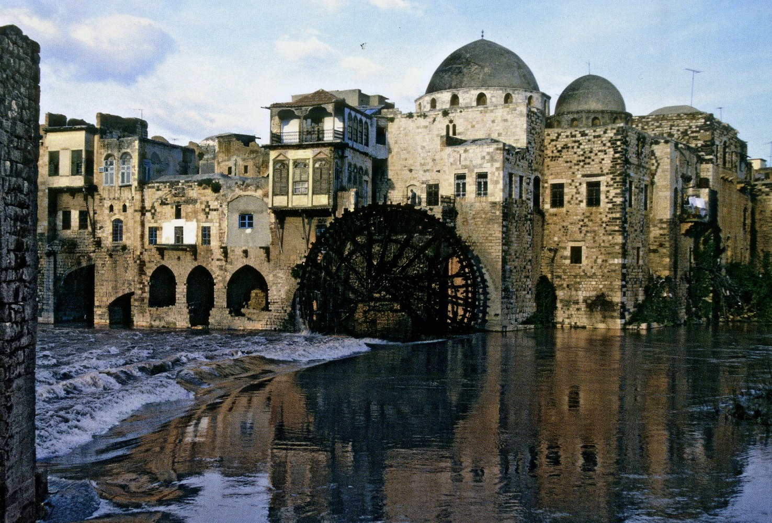
Part Three
Multiple images per page. Each with their own captions!
image: 469 AD, Waterwheel at Hama, Syria, Byzantium, (CC3)
image: 1035 AD, Brihadesvara temple at Gangaikondacholapuram, Tamil Nadu, By Rajendra Chola, (CC3)
GAHTC ©2017.
Notes:
Presenter Note:
Left Image Source:
Right Image Source:

Slide 7
Part Four: Checklist
Checklist of Deliverables
Consult the “Grant Submission Guidelines” Document for more detail.
Per lecture:
Slides (PowerPoint file)
Lecture Notes (inside the PowerPoint file)
Quiz, quiz answers
Handout
Per Module:
Syllabus
Course description
Lecture Abstracts
Required and suggested readings per lecture
Bibliography
Sources used to compose the lectures and lecture notes
Divided by lecture
About the Authors (optional)
Only use this template if you feel it will be helpful to you. You are under no obligation to use this. We really hope that you find some use in it some part of the provided slides.
For Slides with large amounts of text:
Use lists.
And include the full notes for each slide in the “notes” section below.
Create a sense of hierarchy of information.
Text styles like “Bold, italic, underlined are useful for this, along with size and color/tone.
GAHTC ©2017.

